Slide 1



18th Oct,24
DEMO by Parijat Bhadra
Resources :-
amilib - https://github.com/petermr/amilib
docanalysis -https://github.com/petermr/docanalysis
pygetpapers - https://github.com/petermr/pygetpapers
DEMO LINK COLAB NOTEBOOK

Slide 2
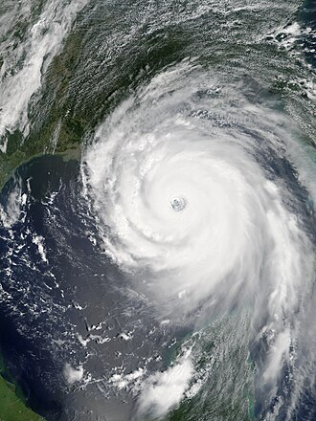
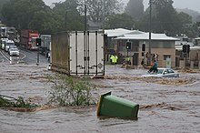
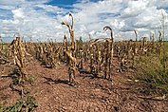
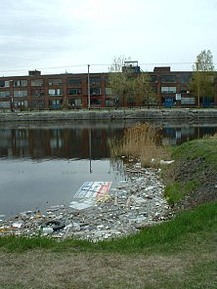
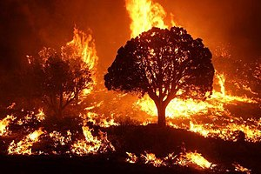
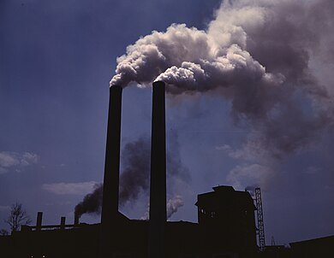
CLIMATE CHANGE

Slide 3
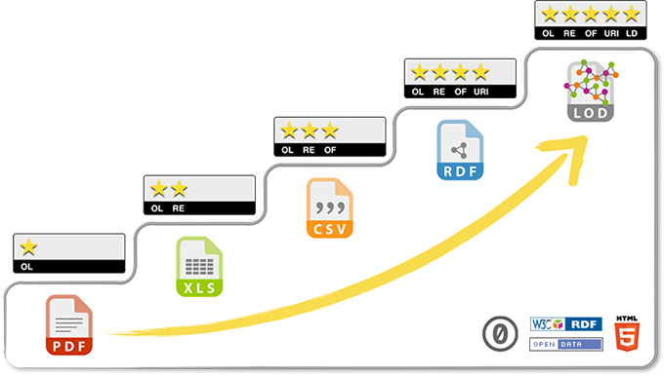

Slide 4
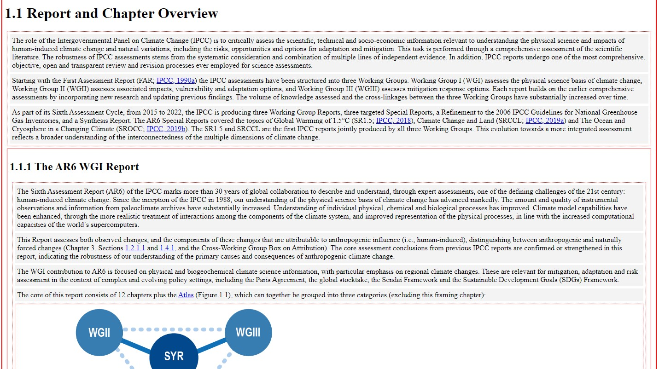


Why are we doing this ?
we believe that open climate knowledge will make contribution to solving the global climate crisis
PDF
(Climate reports)
Semantic document (HTML, machine readable and accessible)

Slide 5
People and Activities
DEVELOPERS
pygetpapers - Ayush Garg
amilib - Peter Murray-Rust
docanalysis - Shweata N Hegde
Jupyter notebooks - Parijat Bhadra, Renu Kumari
Presenter
Parijat Bhadra

Slide 6

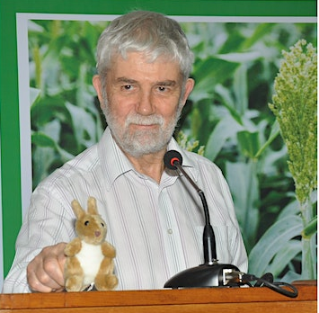
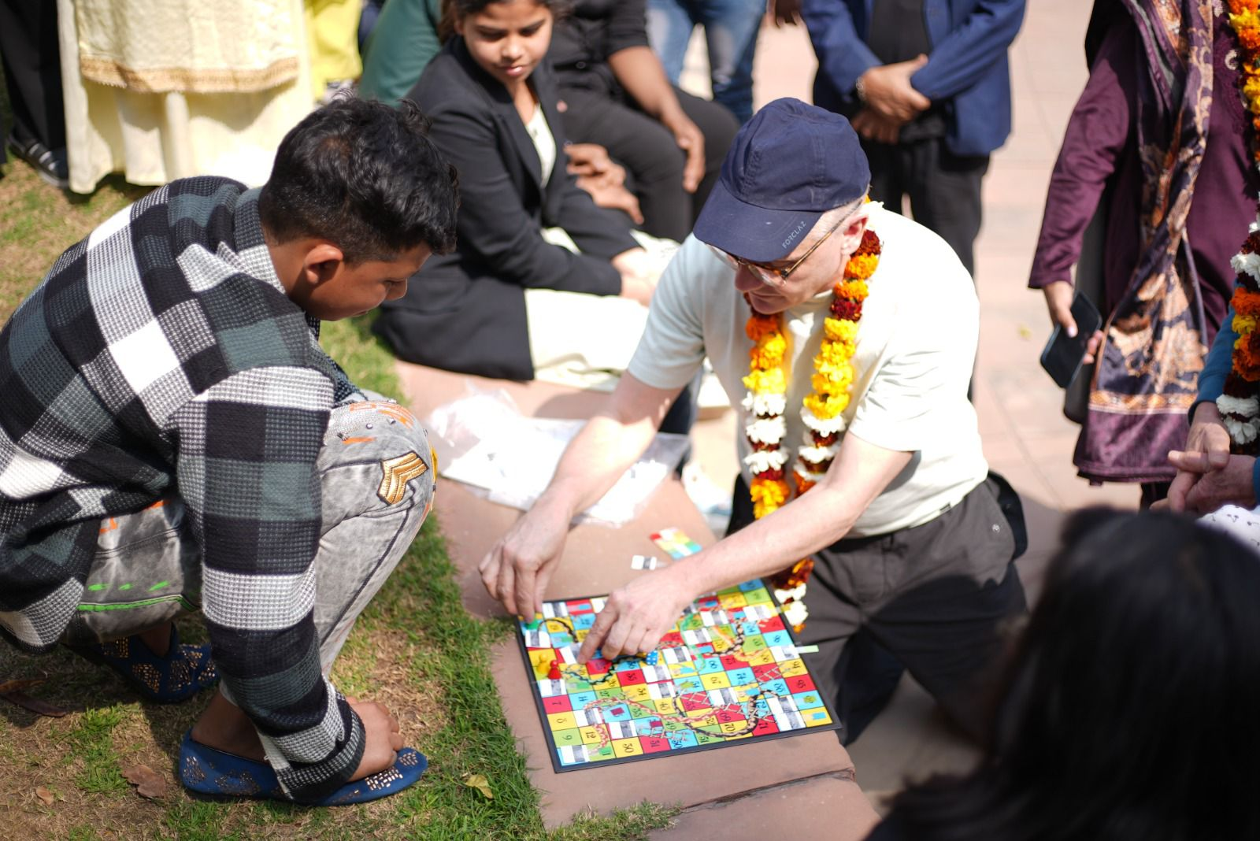
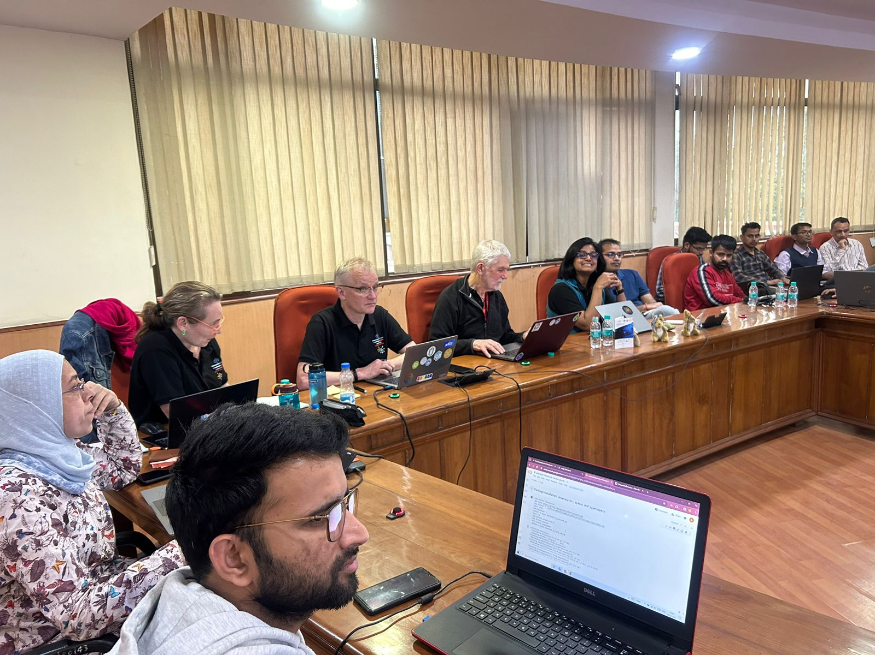

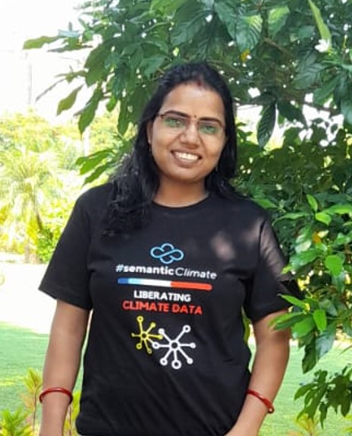
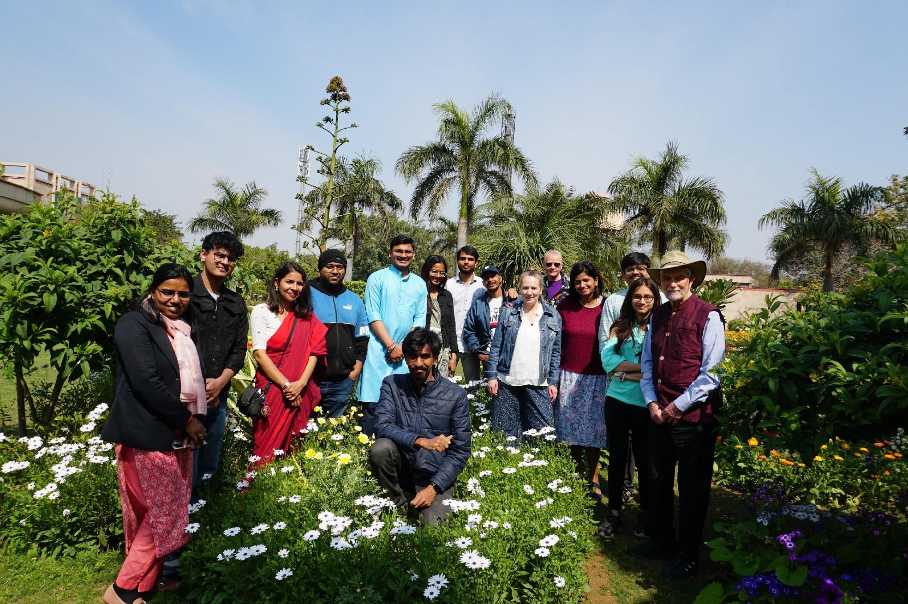
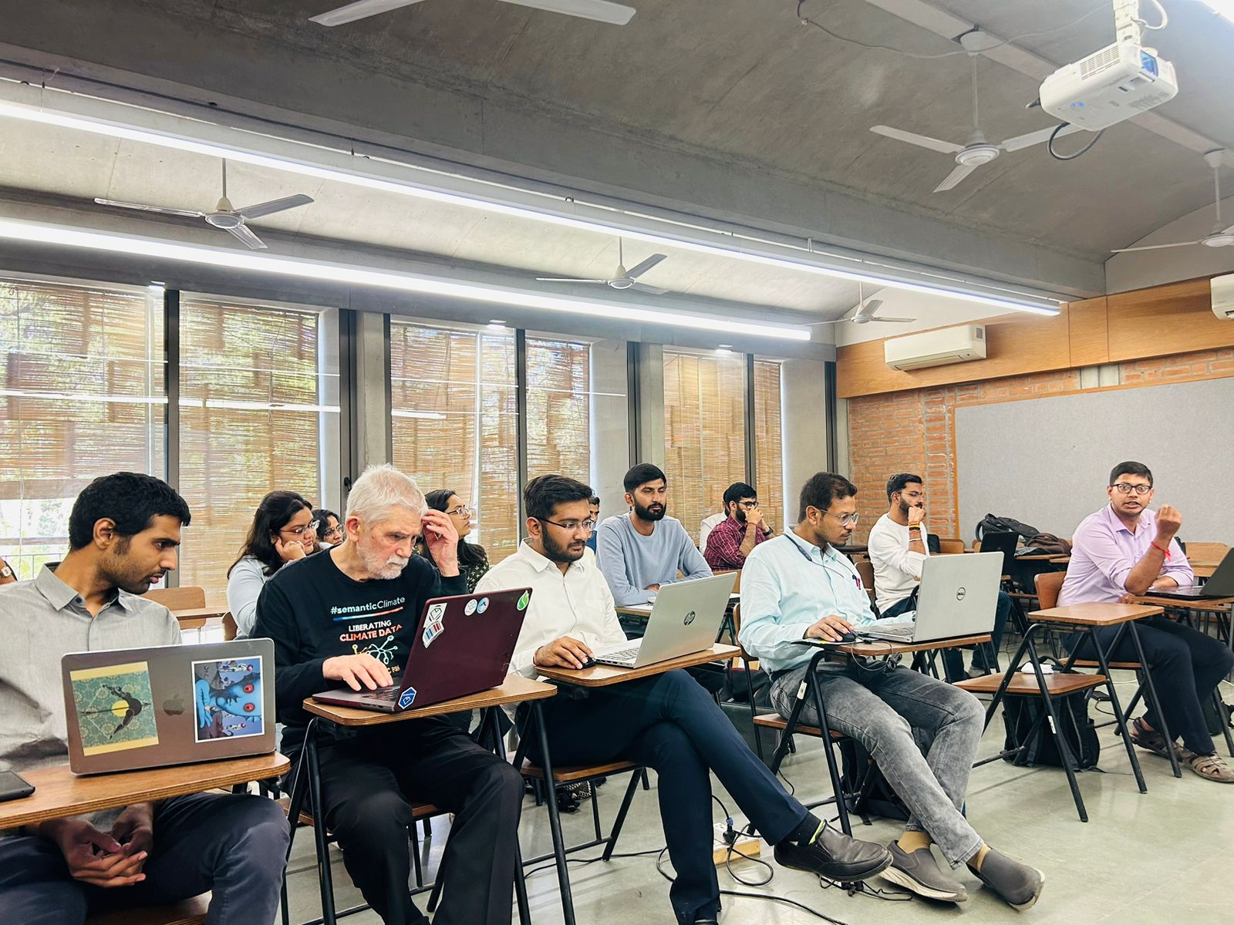
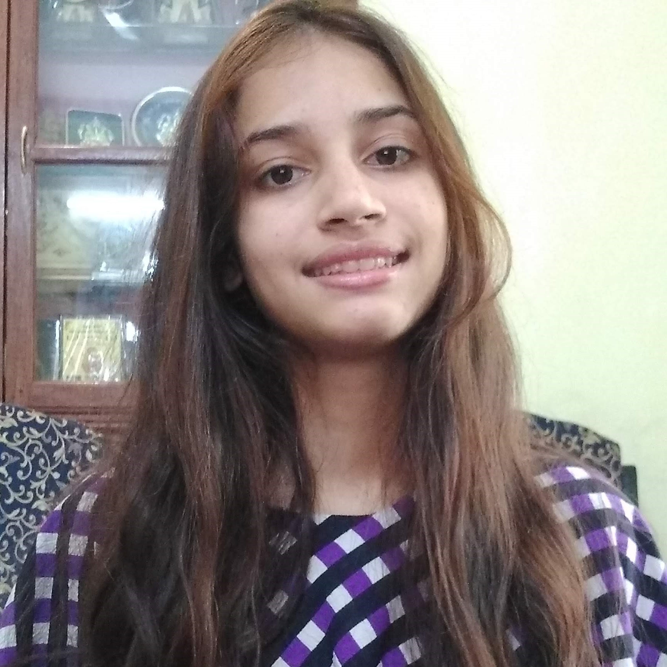
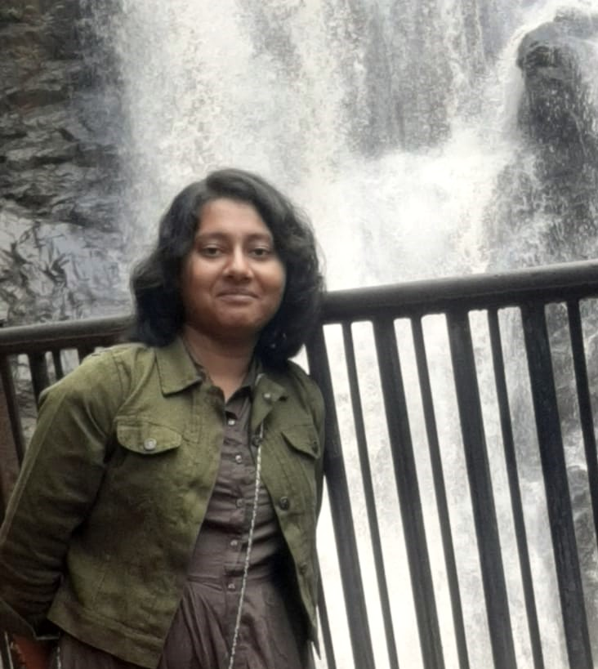
Team
Outreach
Gitanjali Yadav
Peter Murray-Rust
Engaging with highschool students, New Delhi
Hackathon at NIPGR, Delhi
Simon Worthington
Renu Kumari
Alumni reunion
Hackathon at Gujarat
Shweata N Hegde
Parijat Bhadra

Slide 7
The Things We Have
Demonstrations on 24-10-18
Name |  | Purpose
SOFTWARE
pygetpapers |  | Searching the Open Scientific Literature
amilib |  | Creates semantic dictionaries from words. Wikimedia lookup
docanalysis |  | Extracts semantic entities from documents
dictionaries |  | Creates semantic dictionaries from words. Wikipedia/Wiktionary Lookup
DICTIONARIES
IPCC Glossary (DEMO) |  | 1000+ terms/abbreviations from IPCC linked to Wikidata
CORPORA
IPCC Chapters |  | Semantic content for 70+ chapters
UNFCCC Reports |  | "All" the COP reports for 30+ years

Slide 8

Contents
Installation of the tools
Scientific Literature Corpus
pygetpapers
Datatables
Extracting and displaying specific entities (for example COUNTRY names) with docanalysis
4. IPCC Corpus
Wikimedia enhanced Dictionary for the wordlist extracted from the IPCC corpus with amilib

Slide 9
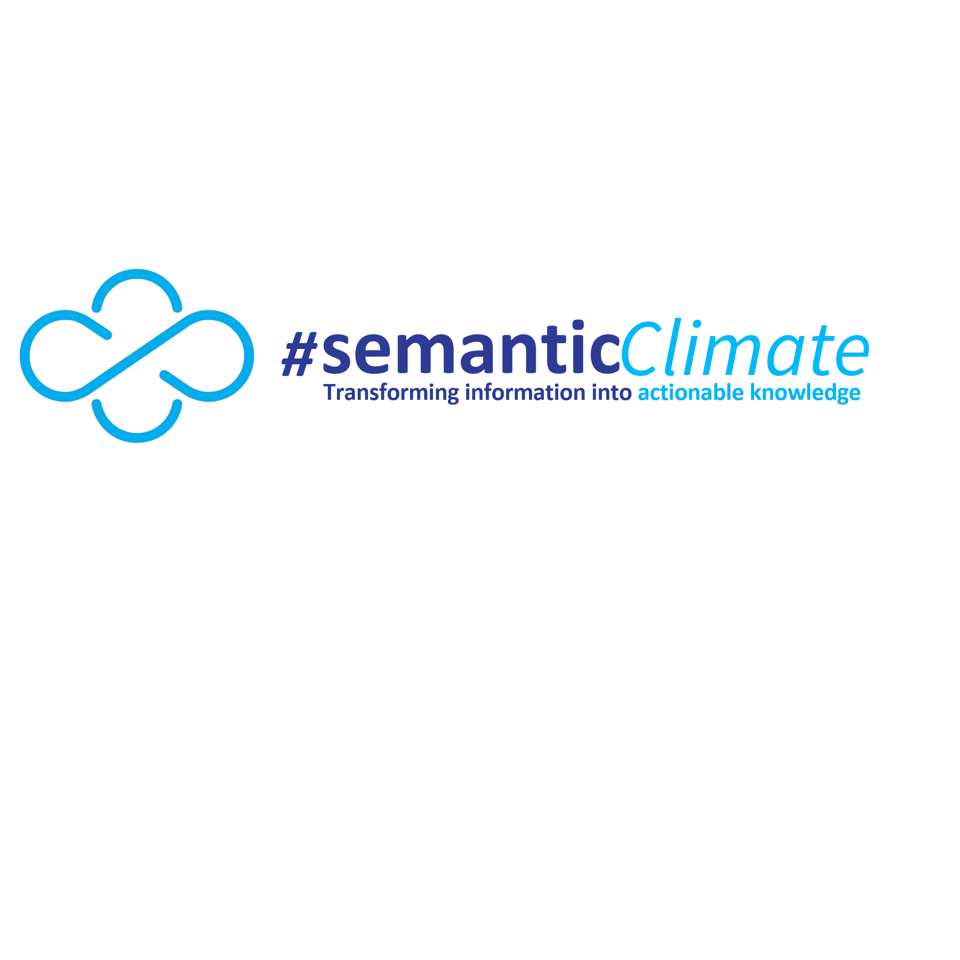


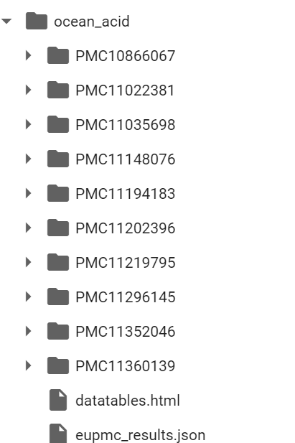

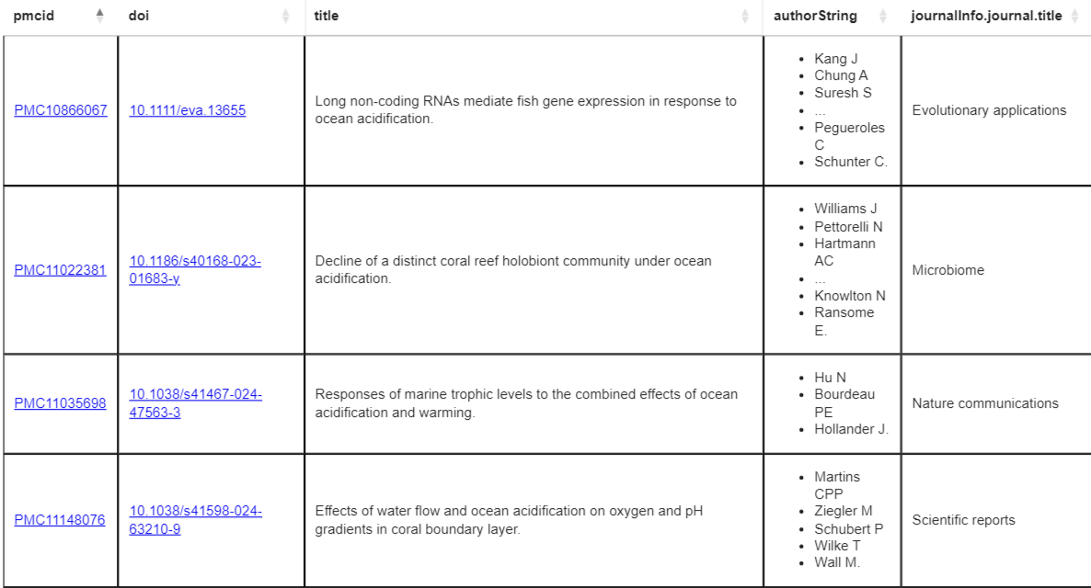
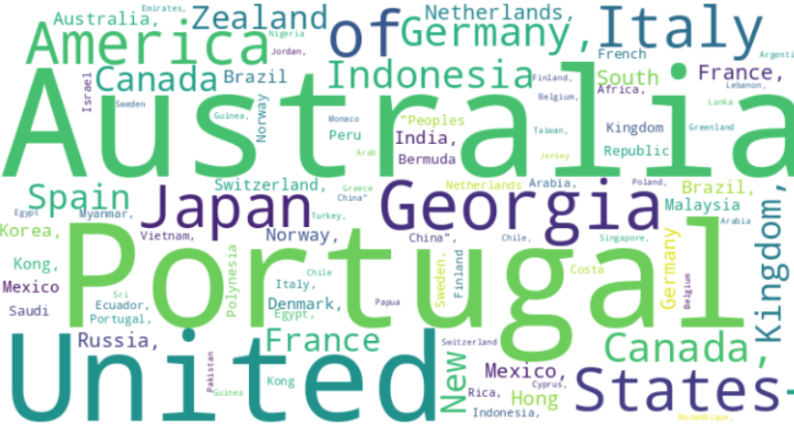
Creating jQuery DATATABLES and Dictionary from scientific literature corpus
Query term
pygetpapers
Ayush Garg
Scientific Literature Corpus
amilib
Extracted Countries
DATATABLES
Shweata N Hegde
docanalysis

Slide 10
Installing our tools on the command line
pip install --pygetpapers
pip install --amilib==0.3.9
pip install --docanalysis

Slide 11
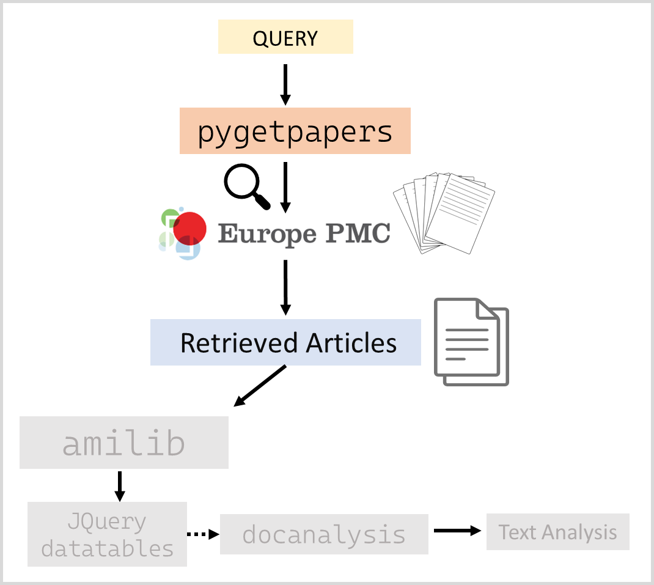
pygetpapers --query "Ocean Acidification" --xml --limit 20 --startdate "2010-04-05" --enddate "2011-04-05" --output ocean_acid --save_query

Slide 12
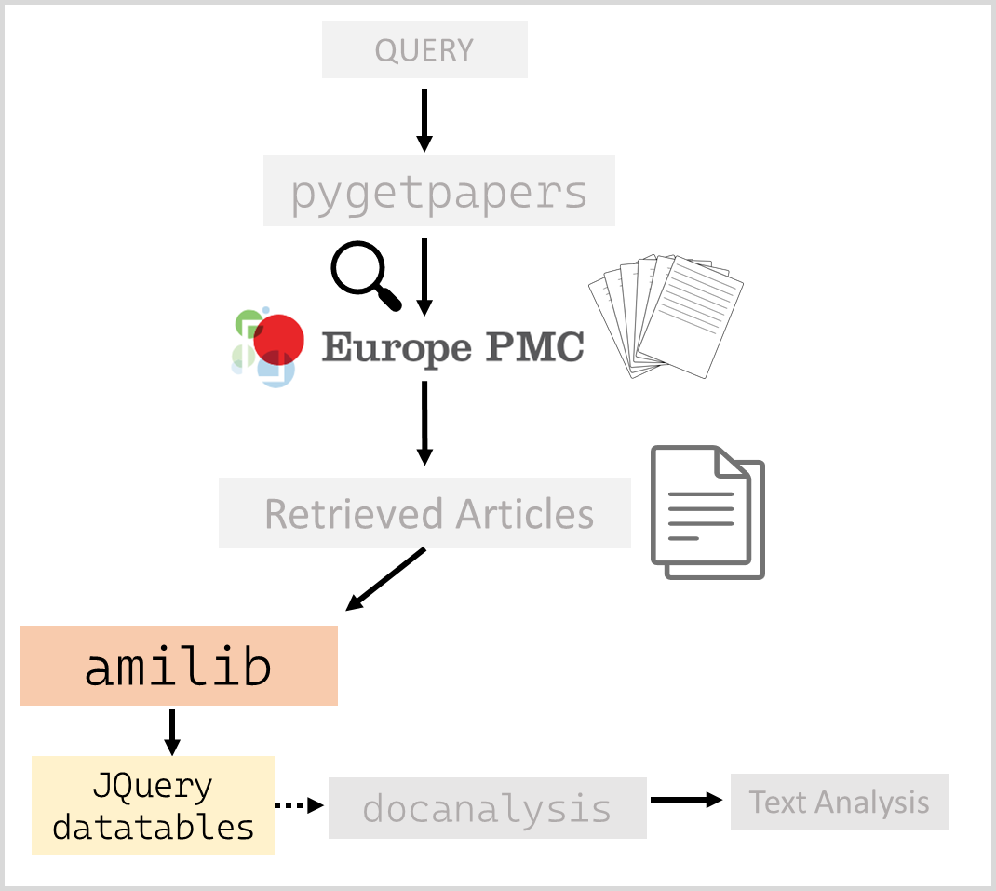
amilib HTML --operation DATATABLES --indir ocean_acid

Slide 13
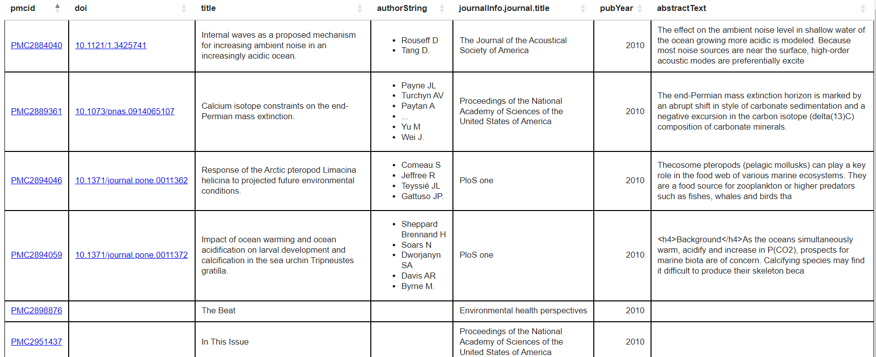
Jquery datatable

Slide 14
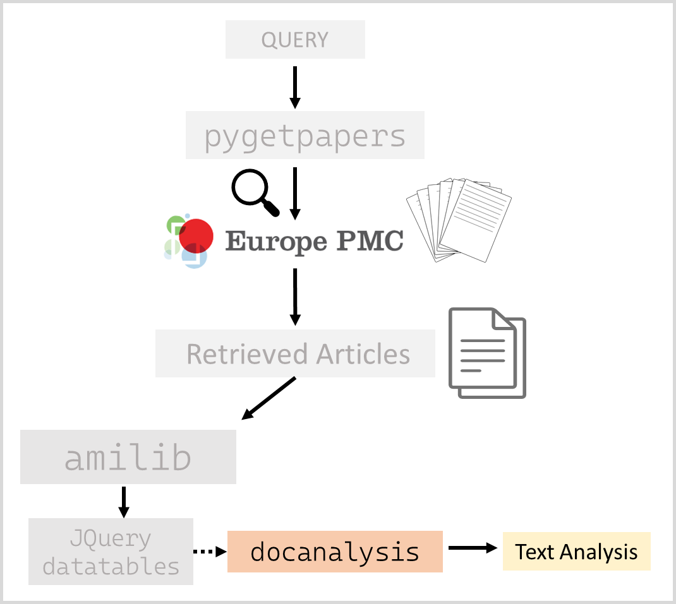
docanalysis --project_name ocean_acid --make_section --dictionary COUNTRY --output ocean_acid.csv

Slide 15
wordcloud

Slide 16
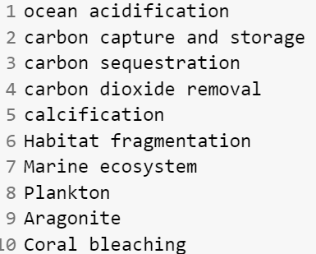
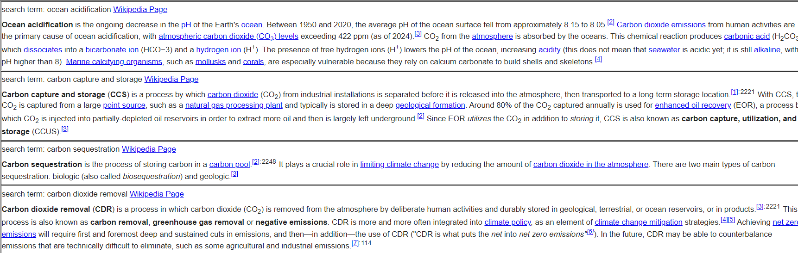
Creating Wikimedia enhanced Dictionary for Climate wordlist extracted from IPCC Corpus
Keyword
extraction
amilib
Dictionary creation
Climate Report
Climate terms
Dictionary

Slide 17
Wikimedia enhanced dictionary

Slide 18
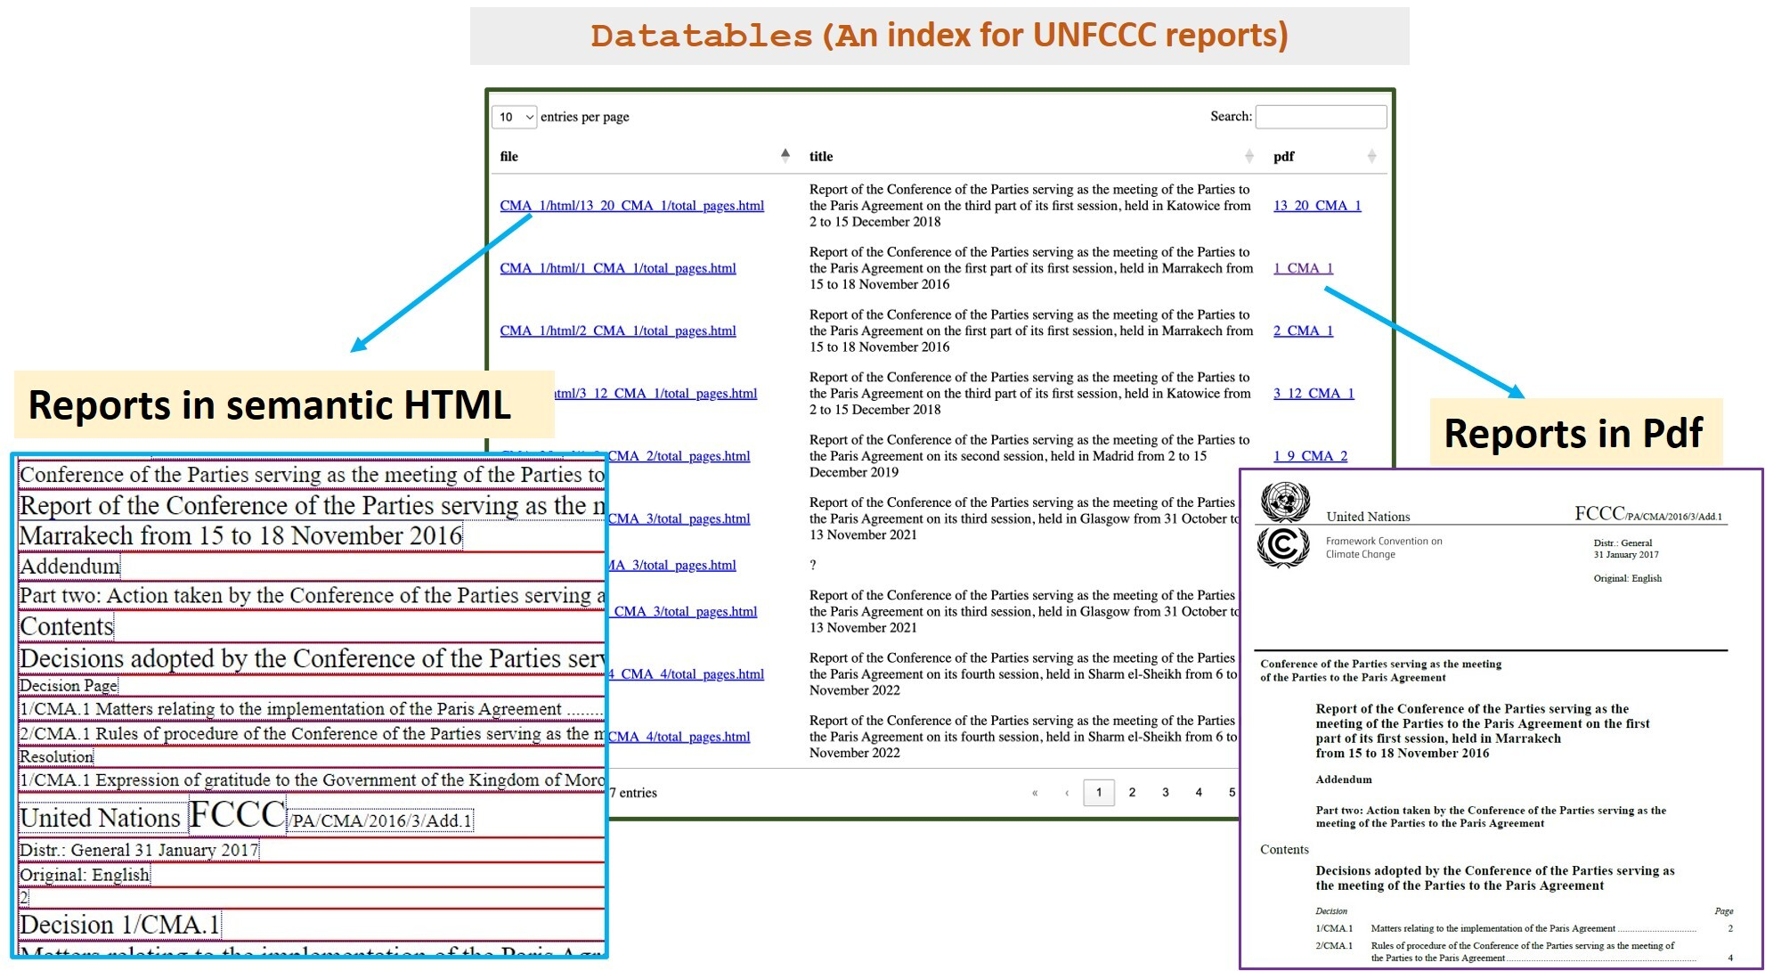

Slide 19
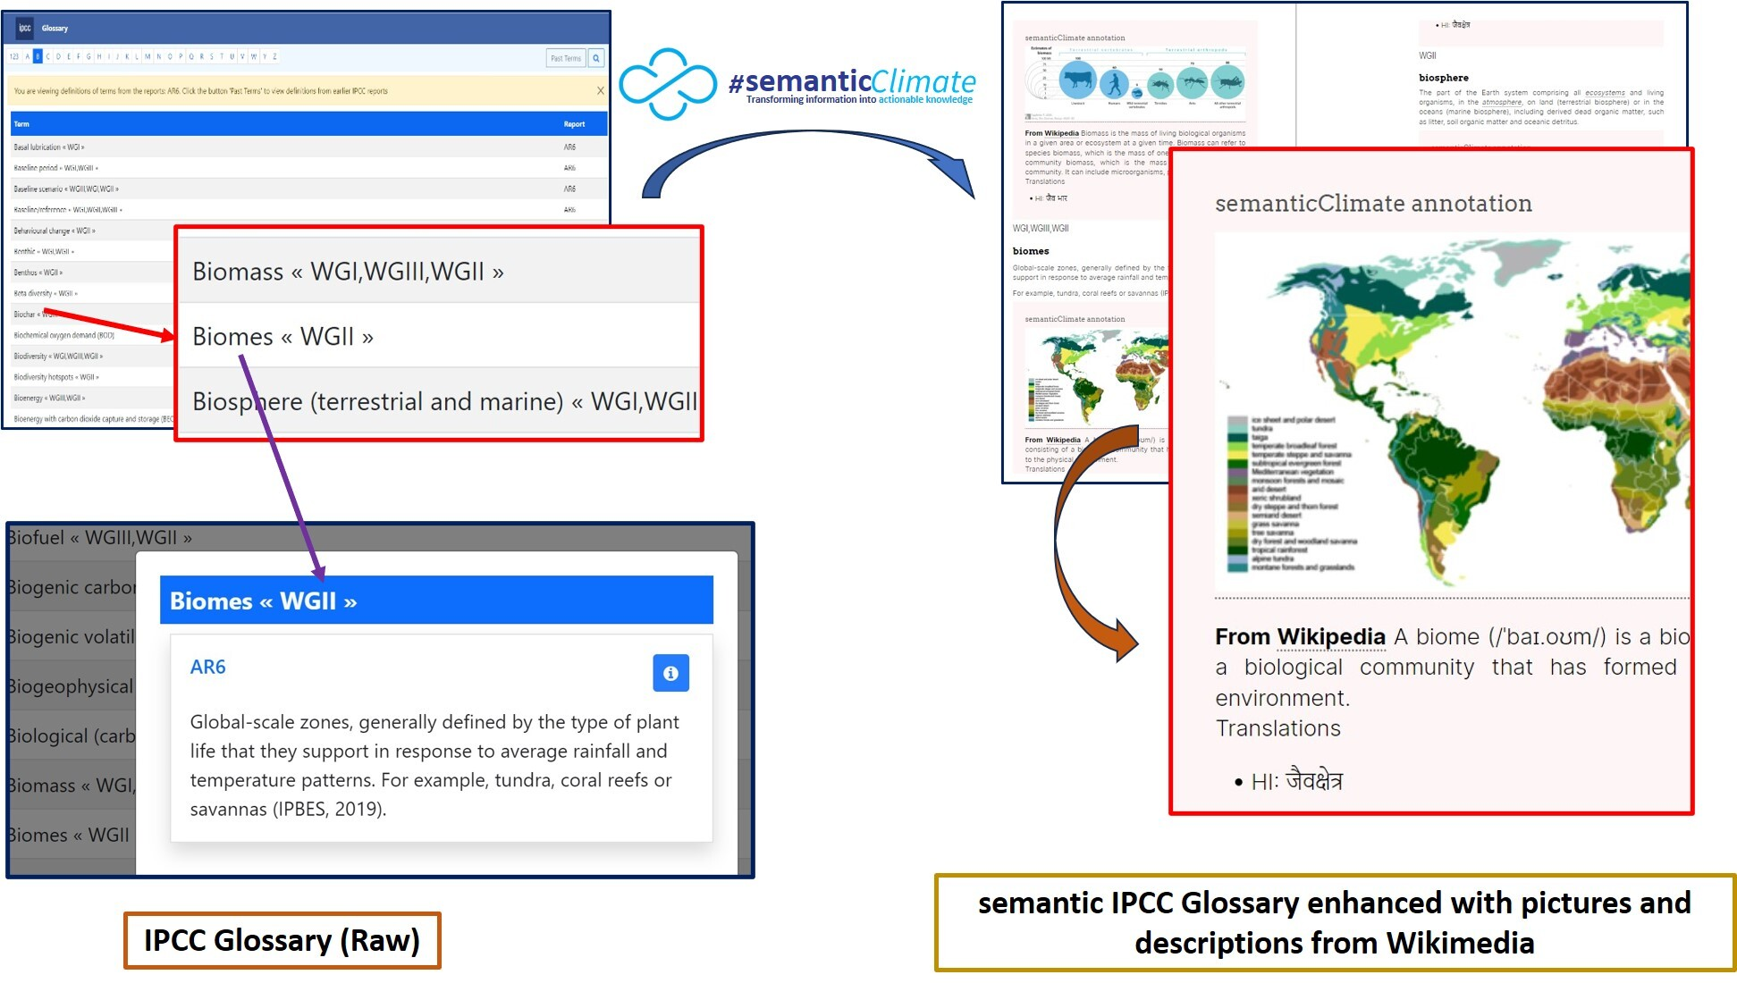

Slide 20
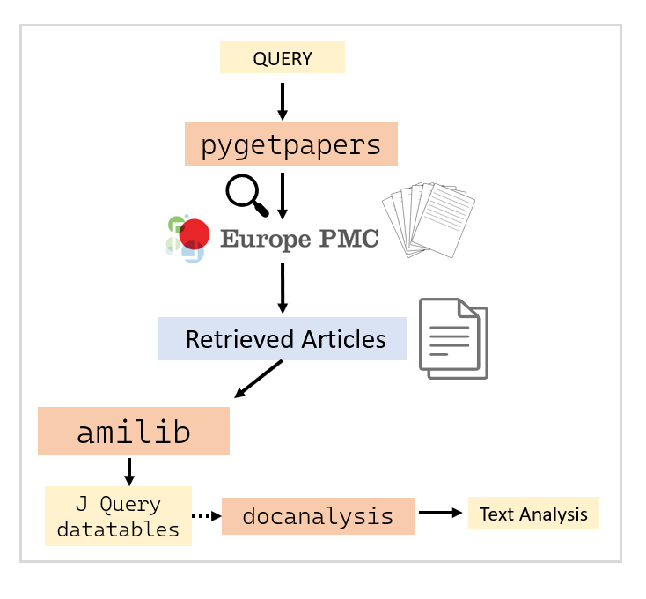

Slide 21
IPCC Report
Keyword Extraction
Wordlist
amilib
Wikimedia enhanced Dictionary

Slide 22
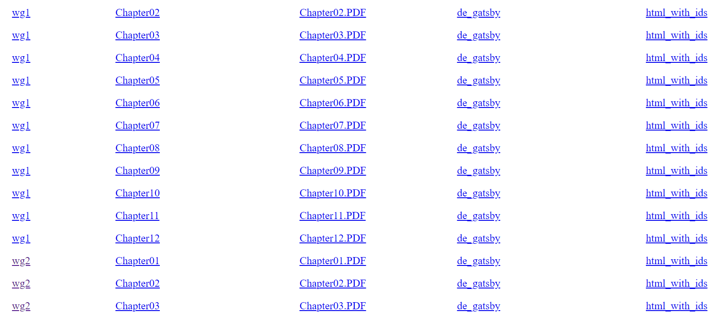
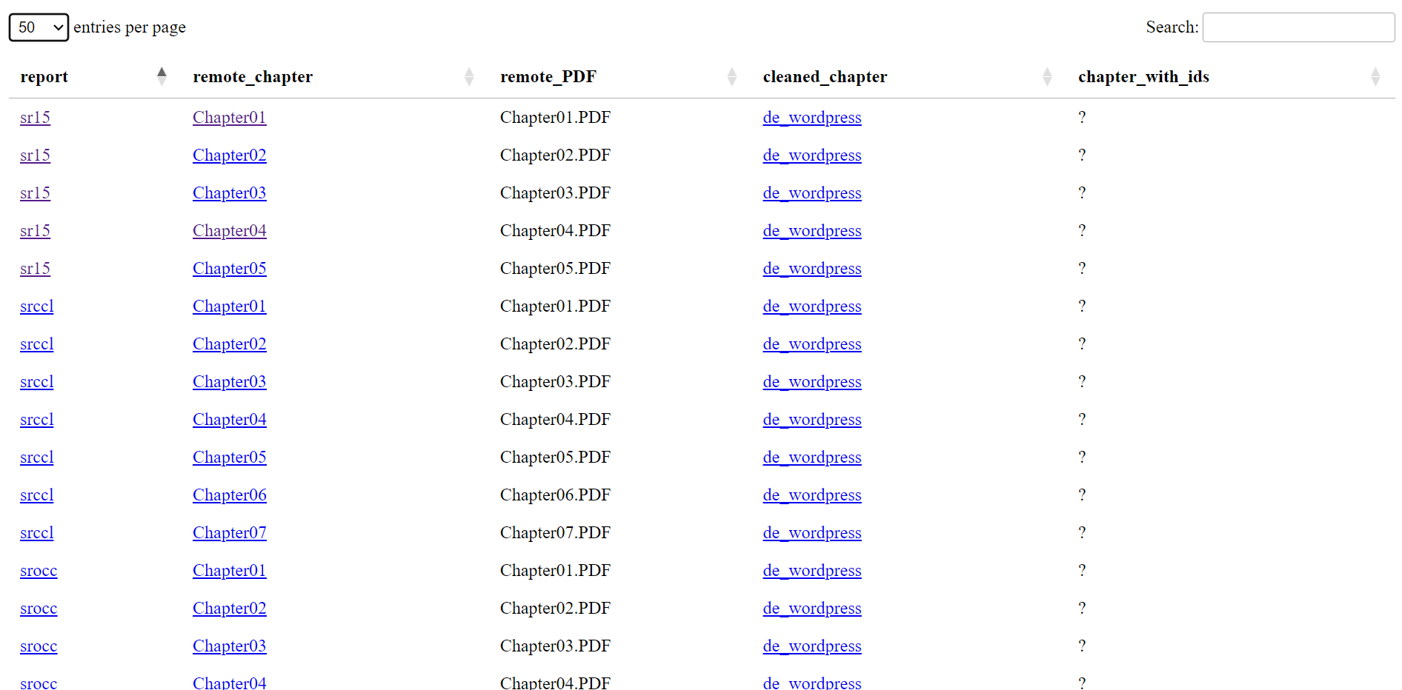
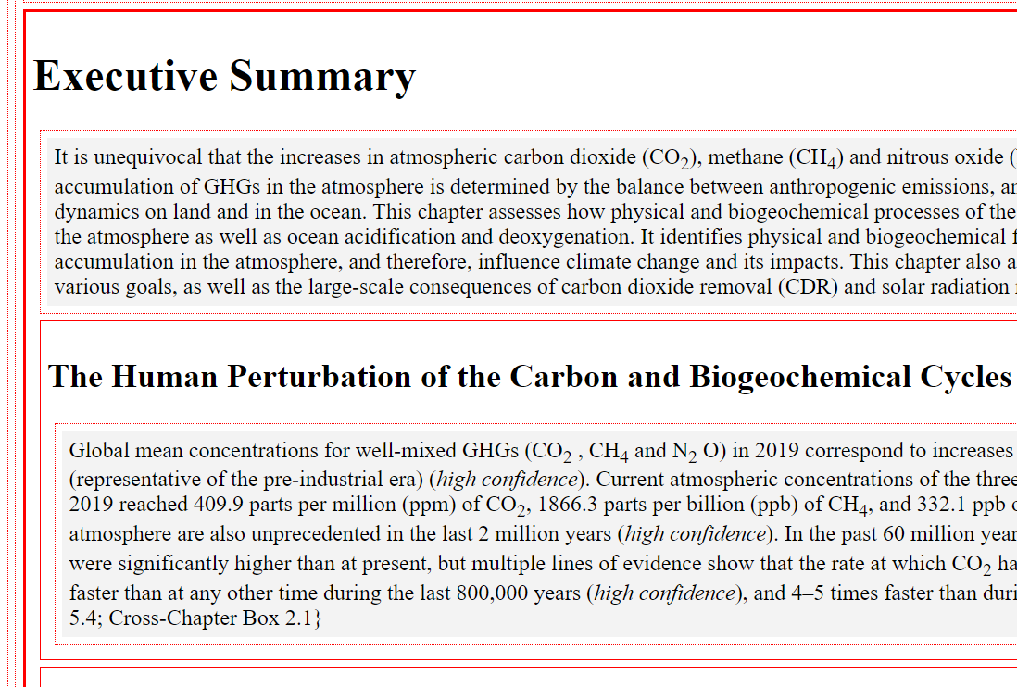
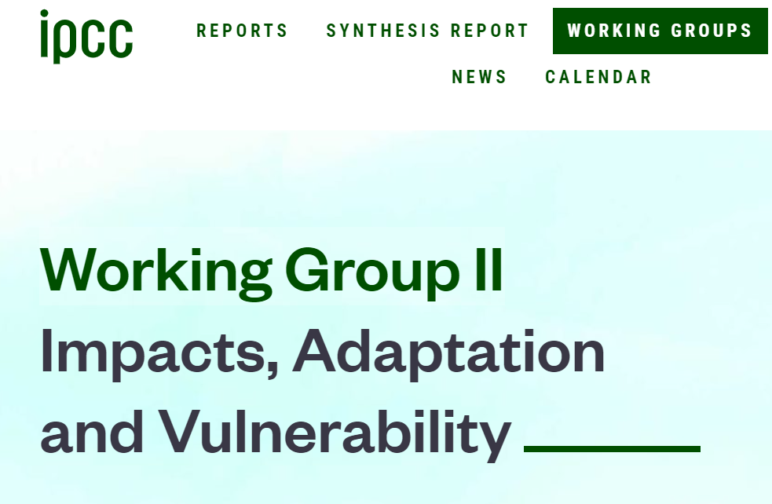
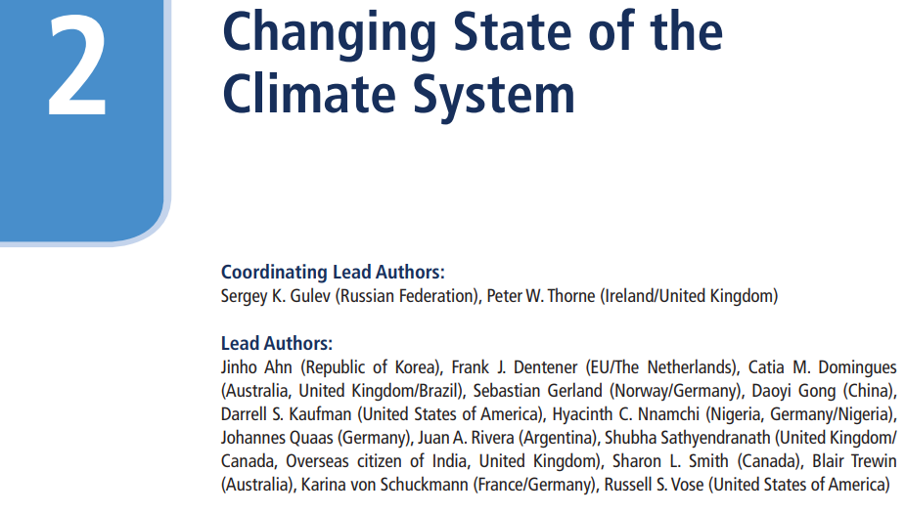
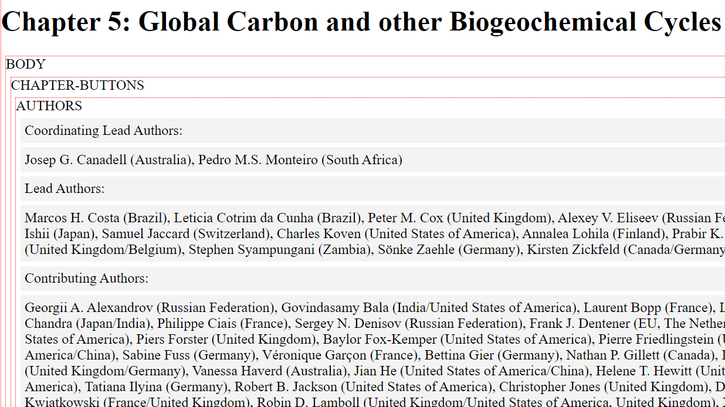
HTML with ids (semantic)
IPCC Chapters
PDF
de_gatsby format

Slide 23
http://semanticclimate.co.in Email: semanticclimate@gmail.com X: @semanticClimate LinkedIn: @semantic Climate
Github: https://github.com/semanticclimate

